Slide 1

FYP REPORT FORMATTING WITH UTM THESIS TEMPLATE 2023
DR. AHMAD FAIZ BIN MOHAMMAD
Senior Lecturer
Department of Mechanical Precision Engineering
Malaysia-Japan International Institute of Technology
Universiti Teknologi Malaysia
Source: UTM Thesis Guidelines 2023

Slide 2
PRESENTATION OUTLINE
Most Important Things
Styles
Tables
Figures
Referencing Tool
Source: UTM Thesis Guidelines 2023

Slide 3
Most Important Things…
Use the latest template ONLY! → UTM Thesis Manual 2023
Must include all the initial pages signed where necessary by you & your supervisor.
Do not change the format of the template. For example, don’t add UTM logo to the cover page! It comes with no logo.
Turnitin similarity percentage < 30% [for the whole report]
Ensure all charts and graphics used are of high quality and resolution.

Slide 4
Most Important Things…continued
All tables and figures must be mentioned and explained in the text.
Click ‘Update Field’ before saving changes to your doc file:
Table of Contents (page viii)
List of Tables
List of Figures
List of Appendices
Also, don’t forget to update these manually upon making changes:
List of Abbreviations
List of Symbols

Slide 5
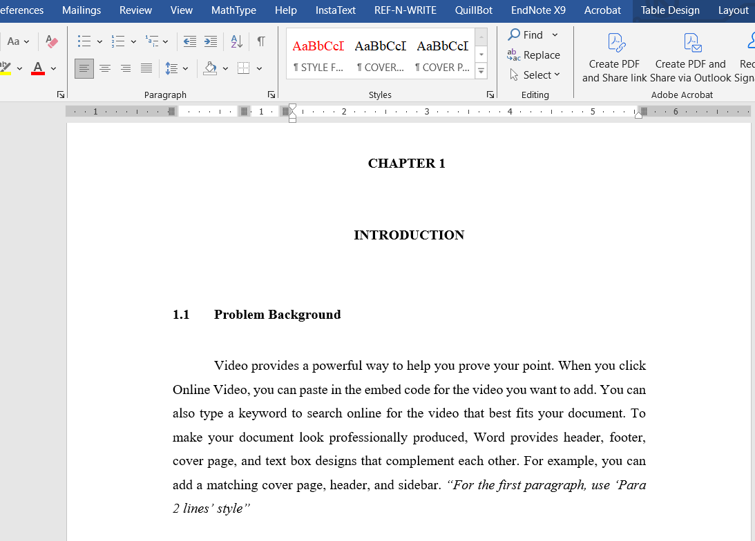
(2) Styles
[1/5]
Use the correct style for every part of the text.
Style: Heading 1
Style: Heading 2
Style: Para 2 lines

Slide 6
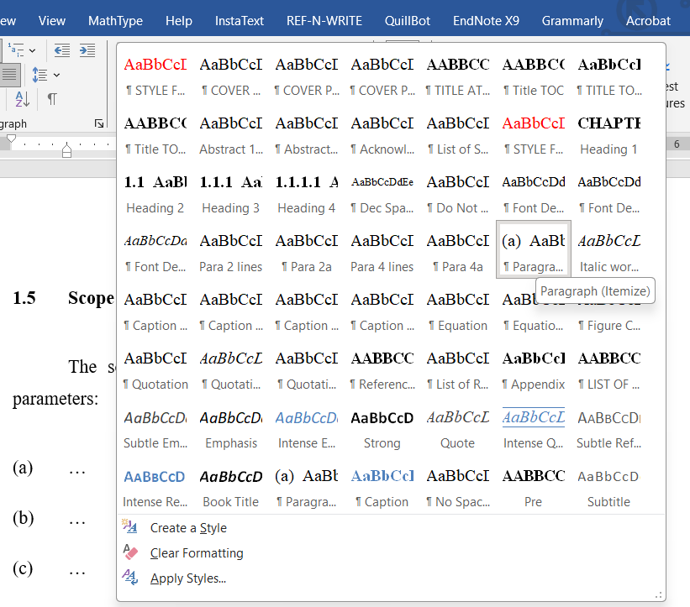
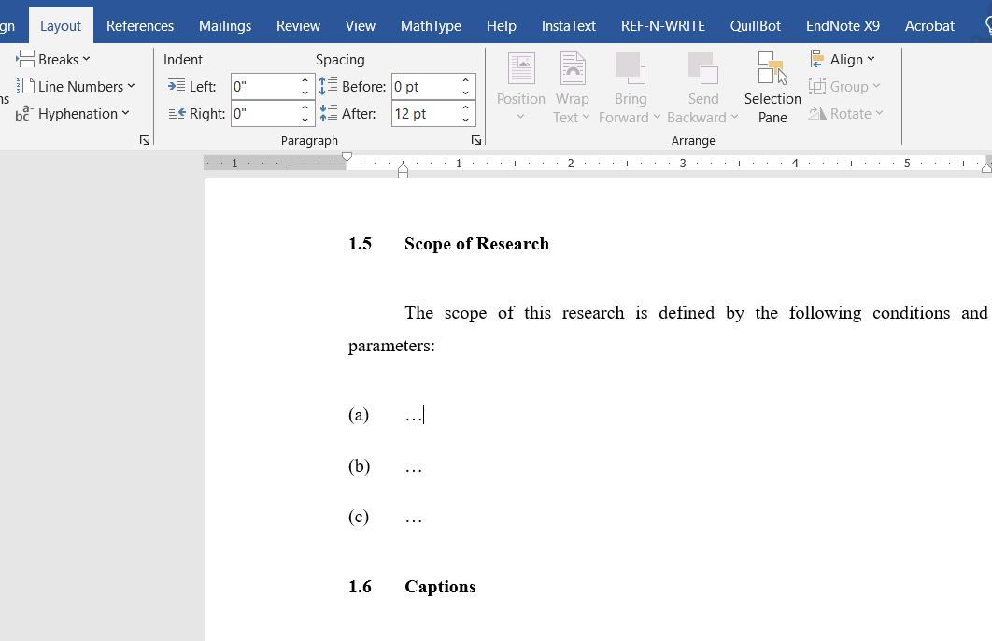
(2) Styles
Styles
[2/5]
A style is applicable for listing items in the text:
Style: Paragraph (Itemize)

Slide 7
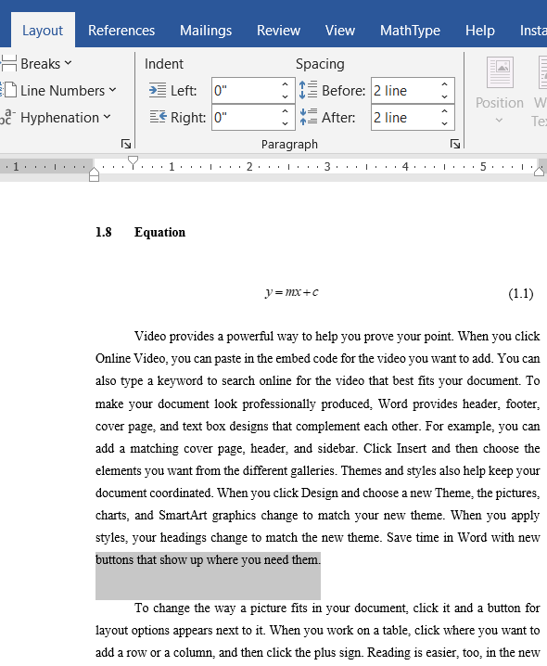
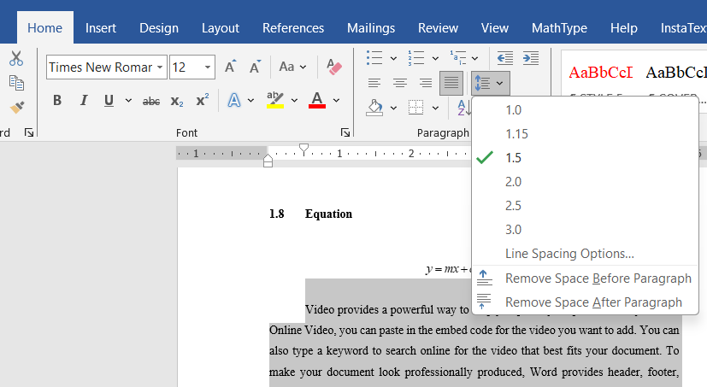
(2) Styles
[3/5]
The last paragraph (or text) of a preceding paragraph must be at a two-line spacing before the next paragraph.
The line spacing in the text is 1.5 throughout the report.
Line spacing
Two-line spacing

Slide 8
(2) Styles
How to select & apply line spacing
[4/5]
The last paragraph (or text) of a preceding paragraph must be at a two-line spacing before the next paragraph.
1
Go to ‘Layout’ tab
3
Type ‘2 line’ in ‘After’
4
Highlight the last point in the list e.g. (c)
2
Spacing becomes two-line

Slide 9
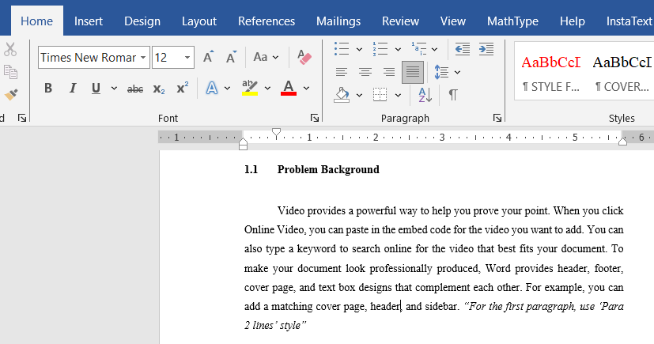
(2) Styles
Paragraph style
[5/5]
Set all paragraphs to ‘Justify’ so that your text is spread out evenly between the two margins.

Slide 10
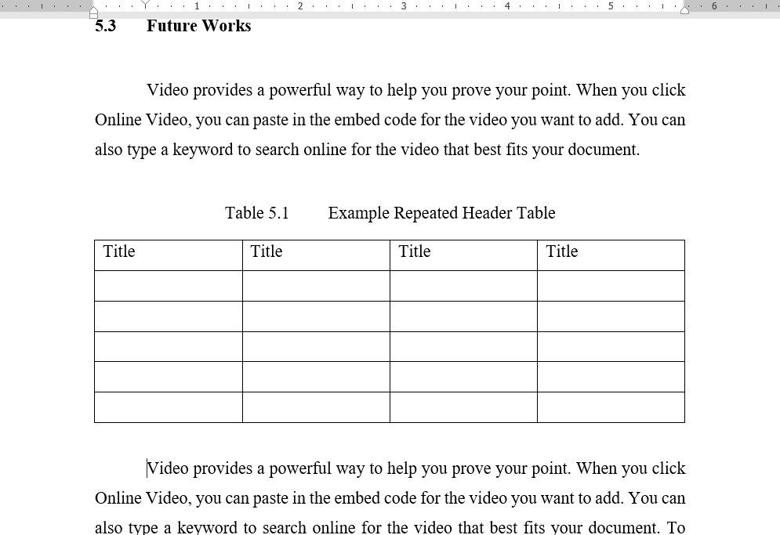
(3) Tables
[1/3]
Tables must be created in the word doc, must not be copied & pasted from other sources as an image.
The caption of a table is above it! NOT BELOW!
One tab
Two-line spacing
One-line spacing
Must be numbered with respect to the chapter.
A table’s caption is centred if it is on a single line.
A longer caption (more than one line) must be set to ‘Justify’
If necessary, a reduced font size of between 10 and 11 may be used for text in the table.
Two-line spacing

Slide 11
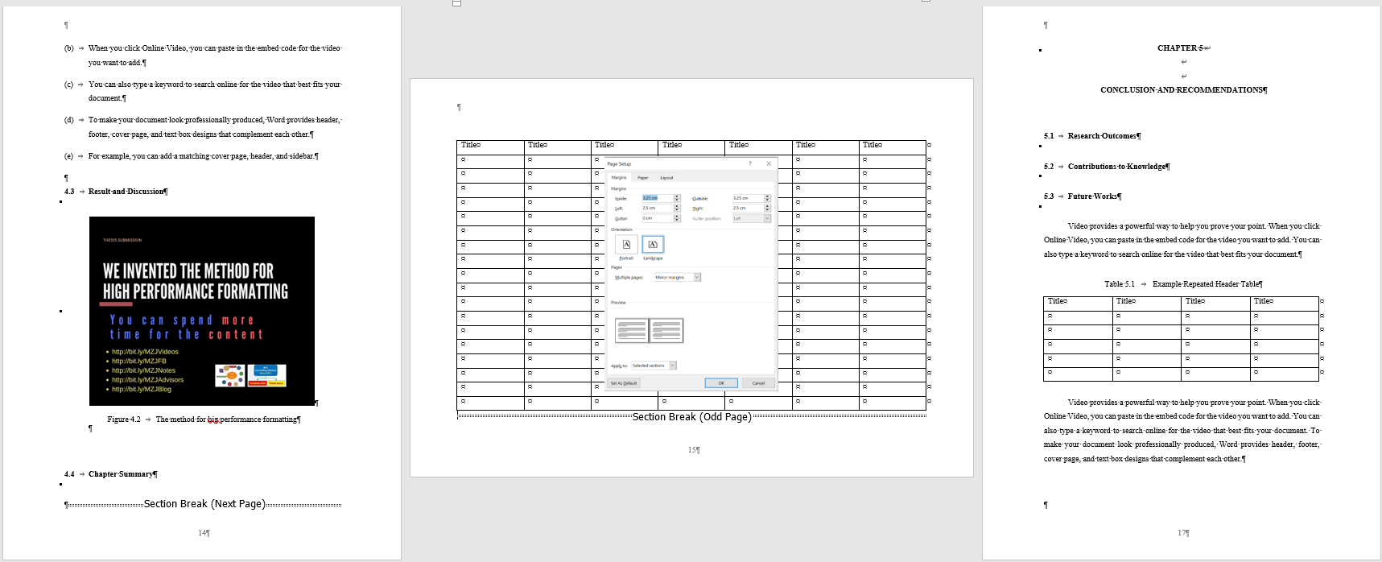
(3) Tables
[2/3]
For a wider table, adjust the page orientation to ‘landscape’ to fit the table in one page.
Before changing the page orientation, insert ‘Section Break’ at the Layout in the preceding page.
And if the next page has a different orientation, insert another ‘Section Break’.
2
1

Slide 12
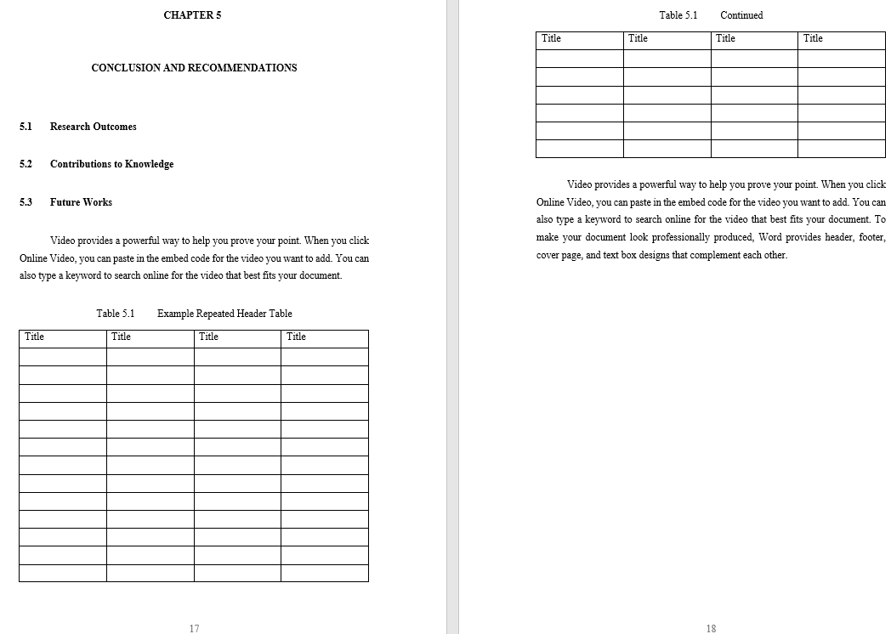
(3) Tables
[3/3]
For a longer table that extends more than one page, the table must be split – and the new table must have the same numbering in the caption and the same header.
Extended table
Header
First table
Header
The extended table should not appear in the List of Tables. Only the first one.

Slide 13
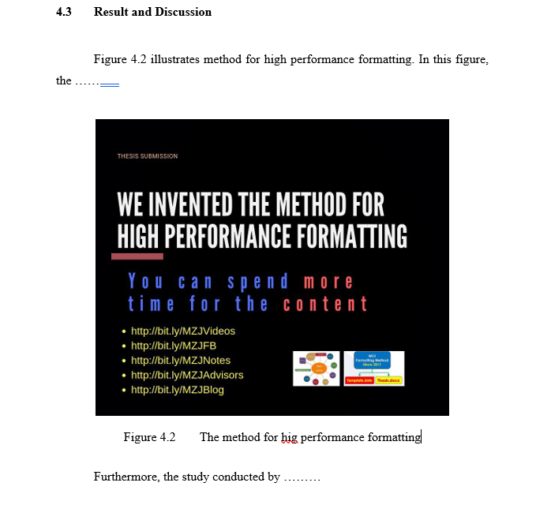
(4) Figures
[1/7]
Figures are illustrations such as maps, charts, graphs, drawings, diagrams, and photographs.
Two-line spacing
Must be numbered with respect to the chapter.
A figure’s caption is centred if it is on a single line.
A longer caption (more than one line) must be set to ‘Justify’
The caption of a figure is below it!
One tab
One-line spacing
Two-line spacing

Slide 14
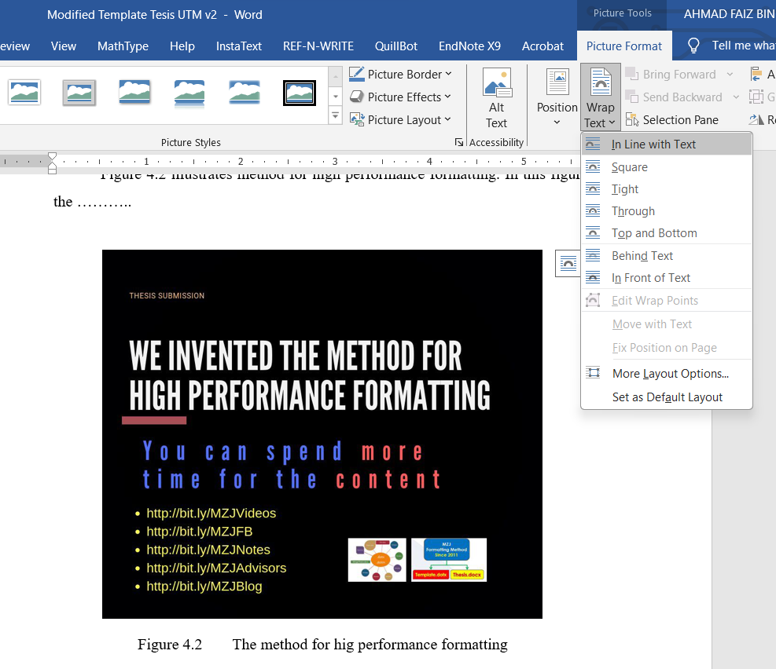
(4) Figures
[2/7]
To construct charts (e.g. flow chart, classification chart etc.), if possible, avoid using shapes and textboxes in word doc.
It’s better to use Powerpoint or other external tool to construct your charts. Then save it as an image file (e.g. JPEG), and copy it into your word doc.
Under Picture Format, use ‘In Line with Text’ to ensure the picture is properly aligned with the text and easy to adjust spacing with its caption and paragraph.
Select this

Slide 15
(4) Figures
[3/7]
Start
To create a flow chart, use the standard shapes or symbols to illustrate the correct flow in a work process (reference material)
An example of a flow chart created using Powerpoint is shown in the figure on the left:
This chart can be saved as an image & used in the word doc.
Equipment installation & model setup
Calibration of hot-wire anemometer (HWA)
Wind speed measurement
Repeat at least three times
Repeat for the next dwelling model
Validation with the pitot tube reading
Is the result
valid?
No
Yes
Data processing & analysis
End

Slide 16
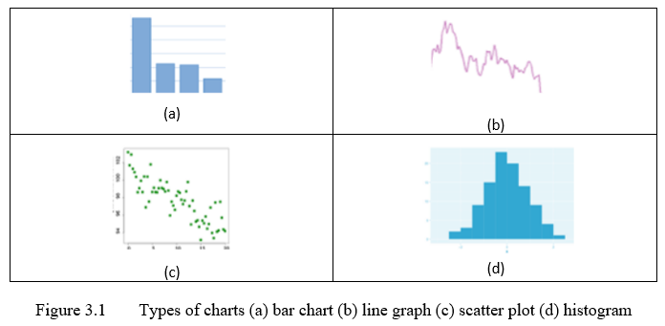
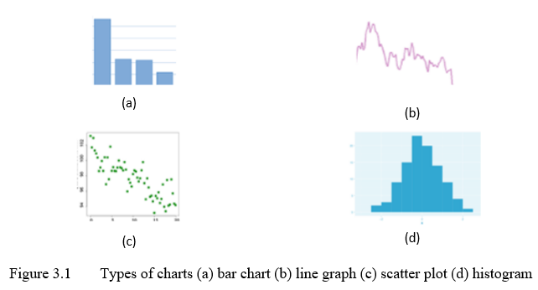
(4) Figures
[4/7]
If you have multiple subfigures sharing the same caption, use a proper technique to arrange the subfigures.
For example, use a table with a certain number of columns and rows where each cell is allocated for a subfigure.
Hide the border
Notes:
Reference: Tips for Citing Figures and Tables in a Manuscript - Enago Academy

Slide 17
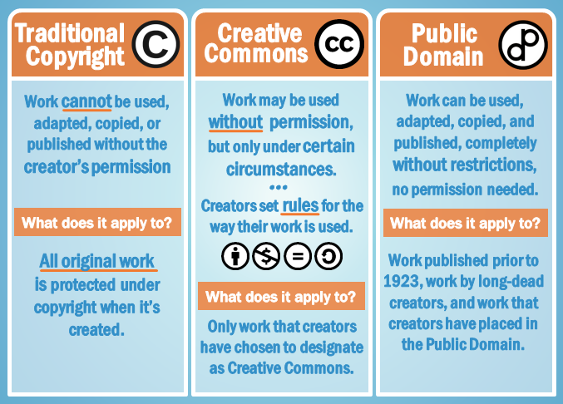
(4) Figures
[5/7]
If you use figures from other sources (e.g. journal, book, internet), you must properly cite its source in the figure’s caption.
Differences among traditional copyright, Creative Commons, and public domain. Retrieved from Use Information Correctly: Copyright and Fair Use (gcfglobal.org) on 8 Dec 2023.
Notes:
Reference: Tips for Citing Figures and Tables in a Manuscript - Enago Academy

Slide 18
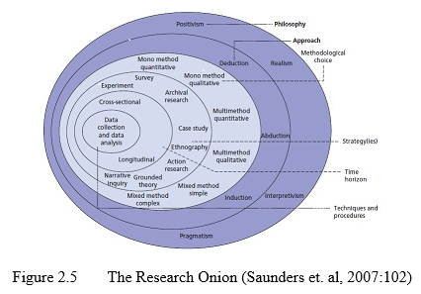
(4) Figures
[6/7]
An example of using a figure from a journal article (Harvard Referencing Style)
The fifth figure in Chapter 2
Author’s surname & year
Page number where the figure is taken
Notes:
Reference: Tips for Citing Figures and Tables in a Manuscript - Enago Academy

Slide 19
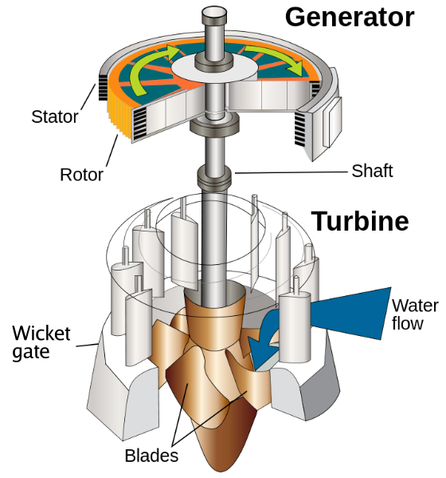

(4) Figures
[7/7]
There are images that belong to the public domain (PD) which consists of all the creative work to which no exclusive intellectual property rights apply.
Figure 2.5 Hydraulic turbine and electrical generator
(Image licensed under Public domain, via Wikimedia Commons)
Notes:
Reference: Tips for Citing Figures and Tables in a Manuscript - Enago Academy

Slide 20
(5) Referencing Tool
[1/6]
A referencing style is a specific format for presenting in-text references (including footnotes or endnotes) and bibliography (i.e., list of references).
What is reference?
An act of mentioning or alluding to something or,
The use of source of information in order to ascertain something.
The style selected must be used consistently throughout the thesis.
You are also advised to check for the latest versions of reference styles, as these styles are frequently updated.
TYPES OF REFERENCING STYLES
Harvard Style Referencing*
American Psychological Association (APA) Style*
Vancouver Referencing Style*
Modern Language Association (MLA) Style
Chicago Referencing Style
Royal Society of Chemistry Style
1
2
3
4
5
6
* Accepted styles in UTM thesis writing
Notes:
Different style of referencing | PPT (slideshare.net)

Slide 21
(5) Referencing Tool
[2/6]
Why we must have references?
To prove that substantial research has been done to support our analysis & work
To enable others to follow up on our work
To give credit to other people’s work
Types of references
Journal
Book
Internet
To avoid charges of plagiarism
To indicate the origin of material & source for research & further reading
Notes:
Different style of referencing | PPT (slideshare.net)

Slide 22

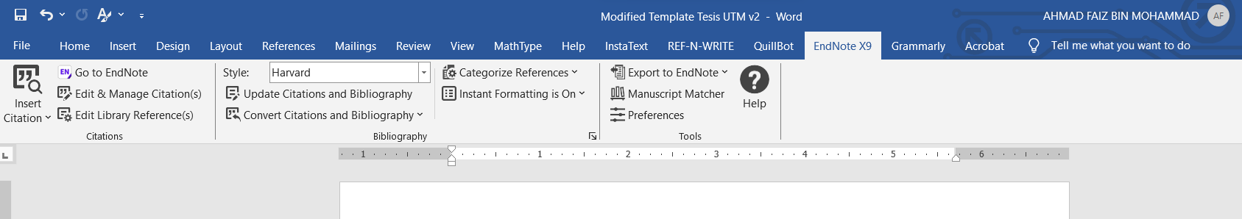
(5) Referencing Tool
[3/6]
Using bibliographic management software can help you keep track of your references, cite and make changes to different reference formats easily and correctly.
UTM's library subscribes to Endnote referencing software for all students and staff. Students can download the software from myUTM portal.
Once you log in to the portal, click on Digital Experience > Software Centre and click on the Endnote icon to download.
Information about Endnote and its training session is available at https://library.utm.my/research-2/turnitin-utm/ .
EndNote tab can be installed in Microsoft Word
Notes:
Different style of referencing | PPT (slideshare.net)

Slide 23
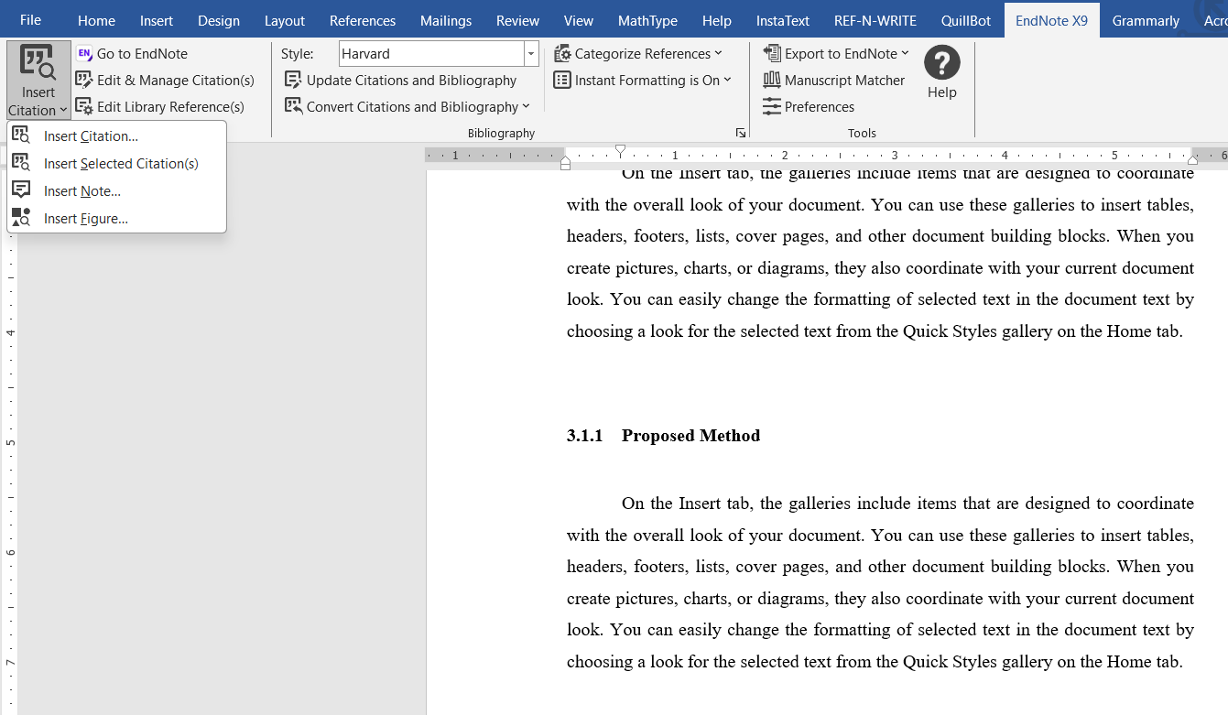
(5) Referencing Tool
How to add citations (i.e., reference sources) in the text.
[4/6]
1
Click the EndNote bar
4
3
Click
‘Insert Citation’
Select the reference style
2
Place the text cursor where you need to add a reference source(s)
Notes:
Different style of referencing | PPT (slideshare.net)

Slide 24
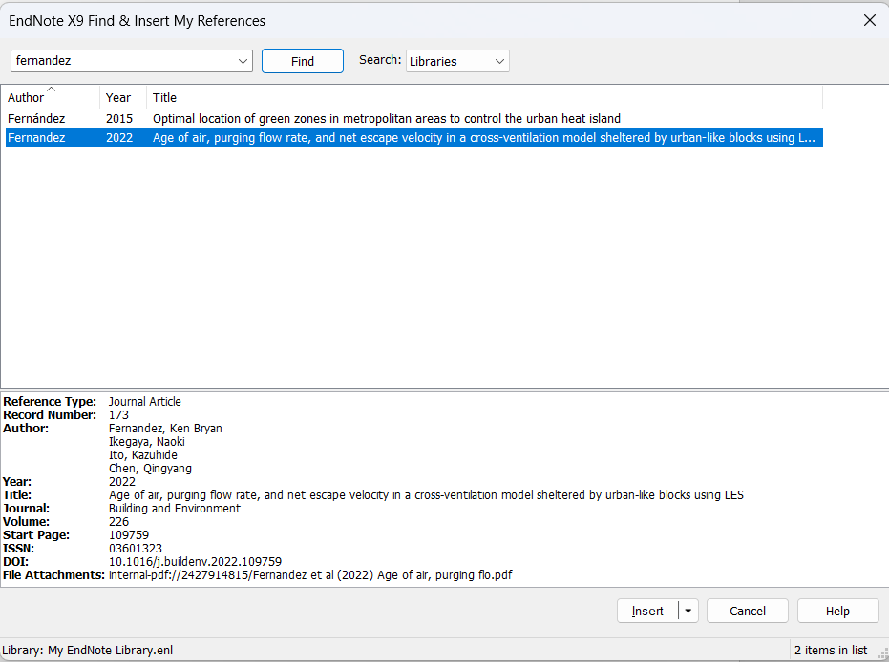
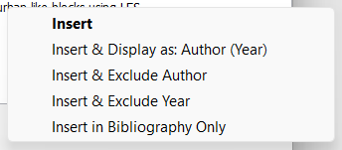
(5) Referencing Tool
How to add citations (i.e., reference sources) in the text.
[5/6]
5
A pop-up window is activated
7
Click a reference that you want to cite
6
Type any word (in an author’s name or title, or year) in the search box & click ‘Find’
A small pop-up window is opened & you can make your selection.
9
(if a citation is in parentheses)
(if a citation is used to form a complete sentence)
Click ‘Insert’
8
Note: Do not confuse brackets [ ] with parentheses ( )
Notes:
Different style of referencing | PPT (slideshare.net)

Slide 25
(5) Referencing Tool
How to add citations (i.e., reference sources) in the text.
[6/6]
Helpful guidance to help you:
ALL GUIDES Alphabetically - Library Guides at AUT University (libguides.com)
How to Cite Pictures in PowerPoint in 4 Different Reference Styles (slidemodel.com)
How To Cite Images in PowerPoint in 5 Steps | Indeed.com
Great sites to search for licensed & free-licensed images:
License | Unsplash
Openly Licensed Images - Finding Open Educational Resources - Research Guides at University of Arkansas (libguides.com)

Slide 26
Question & Answer
Source: UTM Thesis Guidelines 2023

